Slide 1

Smart City
Urban Well-being Analysis and Intervention System
Group 64:
Yulun Feng
Yuelu Zhang

Slide 2
Project Overview & Our Objective
Vision
Mission
Values
To work together to be a First Hotel Brand for young people and Top 1 successful Canadian hotel group.
A total commitment to provide quality and ethical services with new technology to all our customers, clients and partners at all times
Our client wants to ensure the quality service and products are provided to their guests at competitive prices.
Our client strives for a fair return of investment for our stakeholders by practising good management ethics.
Notes:
Yuelu Zhang

Slide 3
System Features
Real-time data collection
Wellness Scoring System
Root Cause Identiication
Customers experiencing the cost of hotel in Canada to be relatively high, affecting their perception of value for money.
In popular tourist destinations or during peak travel seasons, customers might face difficulties in finding available rooms, they have limited choice. Booking platforms and hotel policies also add to the complexity, such as non-refundable bookings or hidden fees.
Customers increasingly expect seamless digital experiences, from booking to check-out. Hotels that fail to offer user-friendly online interfaces, efficient online customer service, or might lose potential travelers.
Notes:
Yulun Feng

Slide 4
System Architrecure
High Price
Availability Challenges
Technological Integration
Customers experiencing the cost of hotel in Canada to be relatively high, affecting their perception of value for money.
In popular tourist destinations or during peak travel seasons, customers might face difficulties in finding available rooms, they have limited choice. Booking platforms and hotel policies also add to the complexity, such as non-refundable bookings or hidden fees.
Customers increasingly expect seamless digital experiences, from booking to check-out. Hotels that fail to offer user-friendly online interfaces, efficient online customer service, or might lose potential travelers.
Notes:
Yulun Feng

Slide 5
UI/UX Wireframes
Canadian Hotel market experiencing rapid growth and evolution driven by advancements in technology and changing consumer preferences. As our brand strives to enhance guest experiences, streamline operations, and maximize efficiency, the need for a comprehensive and efficient hotel management system becomes crucial for the next expanding plan. Moreover, with the rise of online booking platforms and the increasing popularity of using mobile devices for travel planning, hotels must adapt by offering seamless online reservation systems and guest-facing mobile applications for various hotel services.
Notes:
Yuelu Zhang

Slide 6
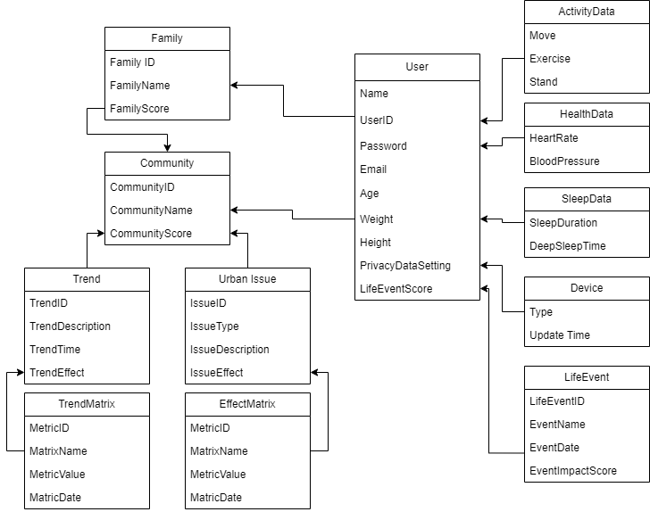
Domain Model
High Price
Technological Integration
Notes:
Yulun Feng

Slide 7
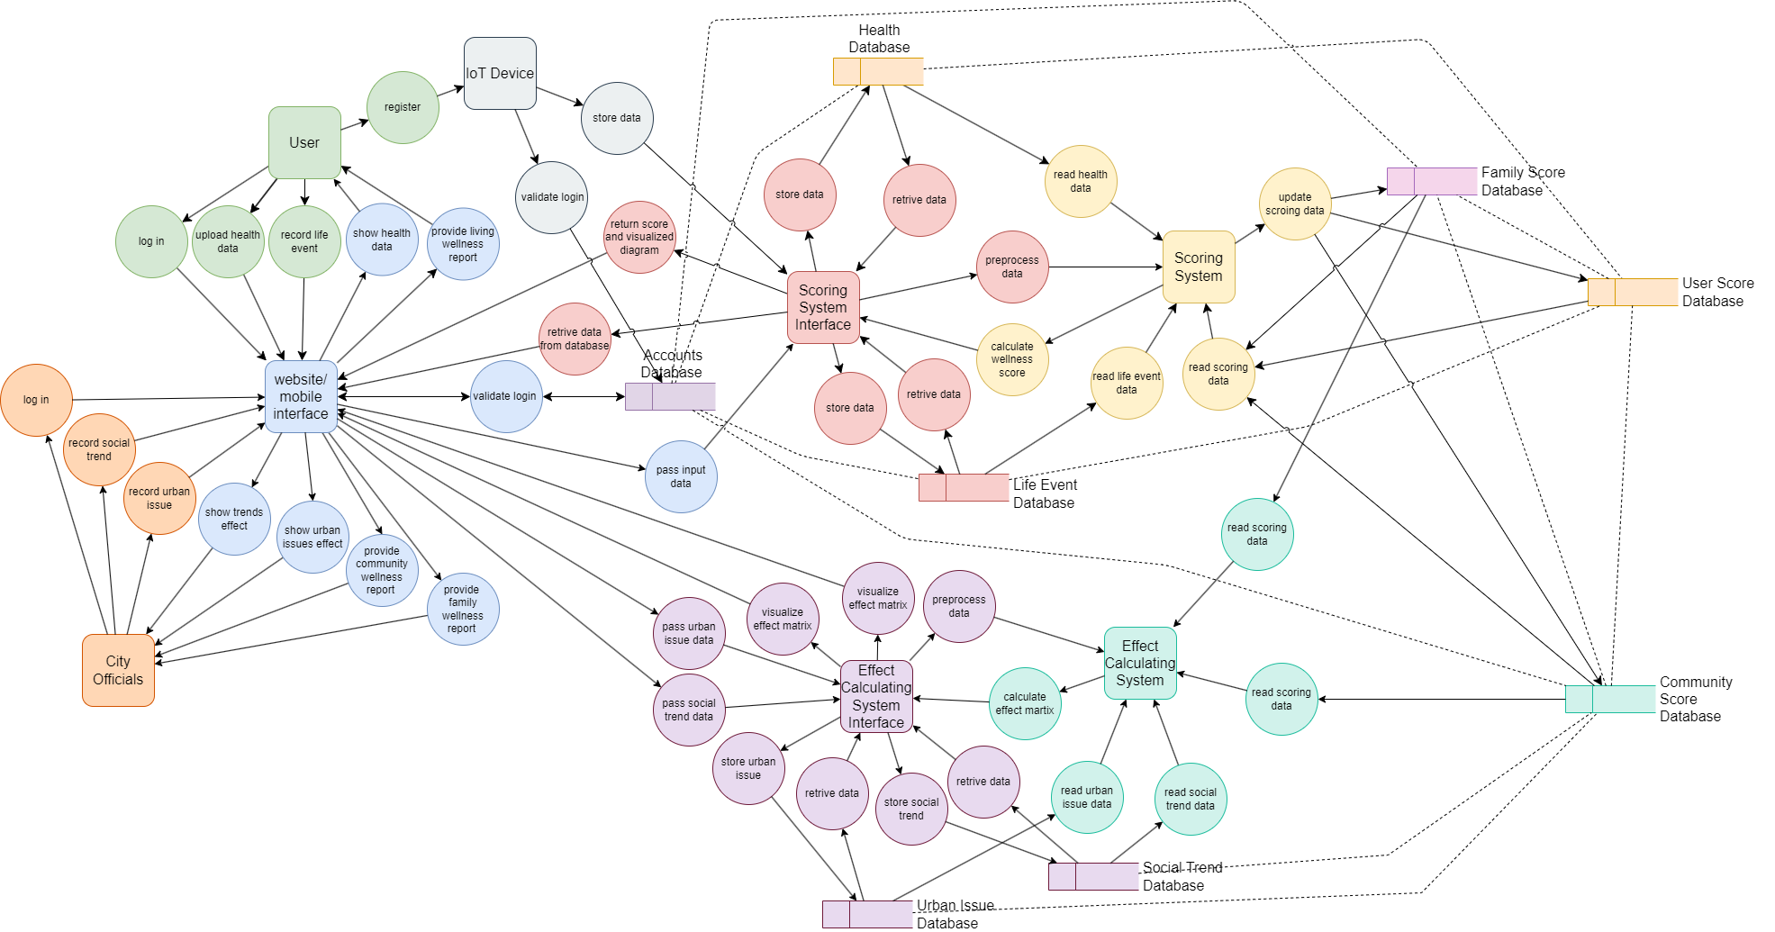
System Data Flow
Notes:
Yulun Feng

Slide 8
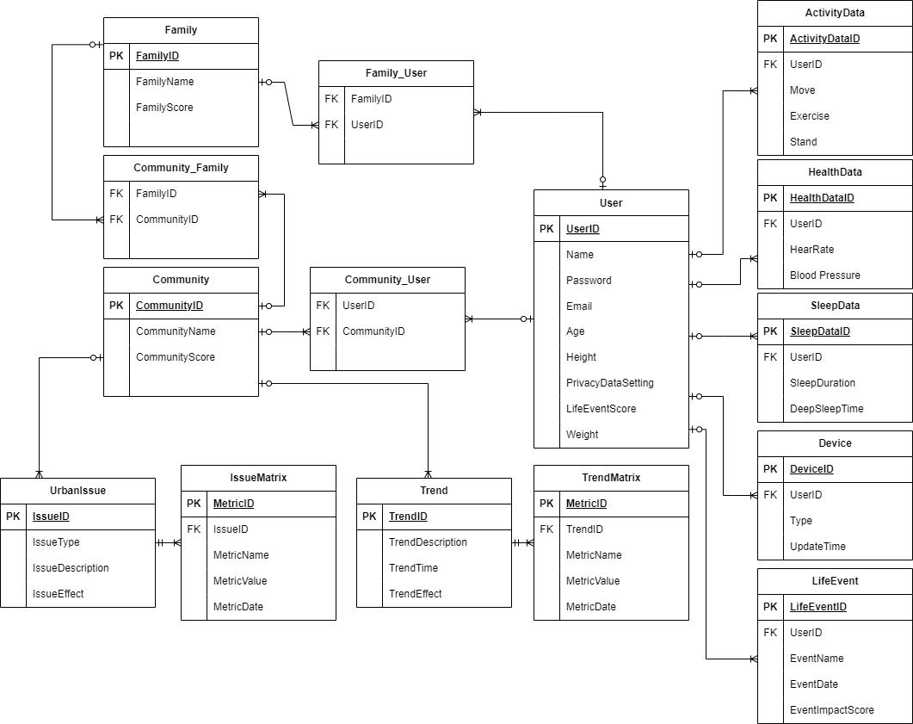
System Database Schema (Encrypted SQL)
Notes:
Yulun Feng

Slide 9
Data Analysis Strategy
Collect & Preprocess
Weight Calculation
Machine Learning
Family and Community Level Adjustment
Phase 2
Load Data
Data Cleaning
Normalization
Encode Categorical Data
Python package used:
pandas
numpy
scipy.stats
sklearn.preprocessing
Define Key Metrics
Assign Weight
Calculate Individual Score
Aggregate Wellness Score
Python package used:
pandas
numpy
Load pre-trained model
Fine-tune the model
Predict adjustment
Combine Predictions with Weighted Score
Python packages used:
transformers
autotokenizer
datasets
Retrieve data
Apply family-level adjustment
Calculate family wellness score
Calculate community score
Adjust for social trends
Python packages used:
numpy
pandas
sklearn.preprocessing
Notes:
Yulun Feng

Slide 10
Challenge Scenarios & Solution Demonstration
1. Constructing a new hospital
2. Implementing a comprehensive health education program
Notes:
Yulun Feng

Slide 11
Challenge Scenarios & Solution Demonstration (cont.)
3. Investing in youth intervention programs
4. Expanding economic opportunity initiatives
Notes:
Yulun Feng

Slide 12
Privacy Policy and Ethic Considerations
High Price
Availability Challenges
Technological Integration
Customers experiencing the cost of hotel in Canada to be relatively high, affecting their perception of value for money.
In popular tourist destinations or during peak travel seasons, customers might face difficulties in finding available rooms, they have limited choice. Booking platforms and hotel policies also add to the complexity, such as non-refundable bookings or hidden fees.
Customers increasingly expect seamless digital experiences, from booking to check-out. Hotels that fail to offer user-friendly online interfaces, efficient online customer service, or might lose potential travelers.
Notes:
Yuelu Zhang

Slide 13
Thank you!

Slide 14
Our Solution and Analysis
Digital Hotel Management System
Data Driven
More Efficiency
Low Cost
Implement guest feedback collection system for continuous improvement.
Utilize data analytics to personalize guest experiences.
Track inventory levels to optimize purchasing and reduce waste.
Analyze occupancy rates to adjust staffing levels efficiently.
Implement predictive analytics for demand forecasting.
Optimize energy usage through smart lighting and climate control systems.
Implement preventative maintenance schedules to reduce repair costs.
Utilize cloud-based software to minimize IT infrastructure expenses.
Offer digital amenities to reduce printing and distribution costs.
Introduce digital check-in/out processes to reduce wait times.
Automate room cleaning schedules based on occupancy data.
Utilize RFID technology for inventory management.
Implement task management systems for staff coordination.
Integrate communication tools to streamline internal operations.
Notes:
Sihui

Slide 15
Success Metrics
Enhanced Guest Experience Metrics
Customer Satisfaction Improvement
Mobile App Adoption rate
Data and Security Metrics
Data Integration Completeness: Successfully integrate 100% of existing data sources (reservation systems, customer feedback, operational systems) into the platform within six months, ensuring a single source of truth.
Privacy and Security Standards Compliance: Maintain 100% compliance with international data protection regulations (e.g., GDPR, PIPEDA) from the outset, with no data breaches or security incidents.
Data-Driven Decision Making: Utilize the platform’s analytics to drive at least a 25% improvement in personalized guest experiences and operational decisions within the first year.
Operational Efficiency and Staff Productivity Metrics
Digital Check-in/out Penetration rate
Housekeeping Optimization
Implement a real-time room status tracking system, aiming to reduce the average room turnaround time by 30% while maintaining quality.
Sustainability and Environmental Impact Metrics
Digital Transition Impact: Achieve a 50% reduction in paper use by transitioning to digital processes for check-in/out, billing, and room service orders within the first year.
Energy and Resource Management: Implement energy and resource management features that result in at least a 10% reduction in energy and water usage within the first two years of platform operation.
Financial Performance Metrics
Direct Booking Rate Growth: Increase direct bookings through the hotel’s digital platform by 30%, reducing commission expenses paid to third-party booking sites by 20%.
Operational Cost Efficiency: Achieve a 20% reduction in operational costs associated with manual processes (e.g., paperwork, manual billing) within the first year.
Revenue Enhancement: Generate a 15% increase in revenue per available room (RevPAR) through improved occupancy rates and upselling opportunities within the first year.

Slide 16
Raw Requirements - Functional
Reservations
Check-in/Check-out
Profile Management
Financial Reporting
Customer should be able to make room reservation online.
Customer should receive an email confirmation once users confirm their reservation.
Admin should receive notification once guests confirm their reservation
Customer should be able to digital check-in/out and the wait times should not longer than 1 minute.
Staff should be automatically assigned checkout room cleaning schedules based on daily checkout data.
Customer should be able to view auto-generated bill when they check-out
Staff should be able to manage detailed guest profile, including customer preference, stay history, and feedback.
This feature should support personalized service delivery and recognizing repeat guest.
Staff should be able to utilizes market data, booking trends, and occupancy rates to adjust pricing dynamically.
Notes:
Automata

Slide 17
Raw Requirements - Functional
Scheduling
Loyalty Program
Feedback
Data Analysis
Staff should be automatically assigned room cleaning schedules based on room occupancy data.
Staff should be able to view tasks in their task queue
Admin should be able to view, add, modify, delete tasks in task system.
Admin should be able to assign staff room service tasks
The system should be able to integrate with customer relationship management system to leverage guest data for marketing, loyalty programs.
Staff should be able to utilize this system to analyze user preference, enhancing guest retention and satisfaction.
Customer should be able to leave a feedback everytime he/she stays in hotel or calls for a service.
Staff should be able to make a response to feedbacks.
Staff should be able to track the trend of recent feedback, and get a feedback report every season.
The system should be able to track gusset behavior, preferences, and trends.
The system should make a prediction of gusset trends based on data collected.
Staff should be able to use these data and prediction to target marketing efforts, and customizing guest experiences.
Notes:
Automata

Slide 18
Raw Requirements - Nonfunctional
Data Security
Hardware Compatibility
Training and Support
Strict data security and compliance with relevant regulations, such as the GDPR for guests from the European Union.
Deployment plan incorporate robust security measures, including encryption, access controls, and regular security audits, to protect guest privacy and maintain the hotel's reputation.
Compatible to all platforms, including computers, mobile devices, and point-of-sale systems.
Use external platforms such as AWS database services to ensure scalability and optimal system performance.
Adopting a backup system that could handle emergency situation.
Comprehensive training for hotel management and staff to ensure proficiency with the new system.
This support network should include both the HMS vendor's technical support and internal IT support for daily troubleshooting.
Notes:
Automata

Slide 19
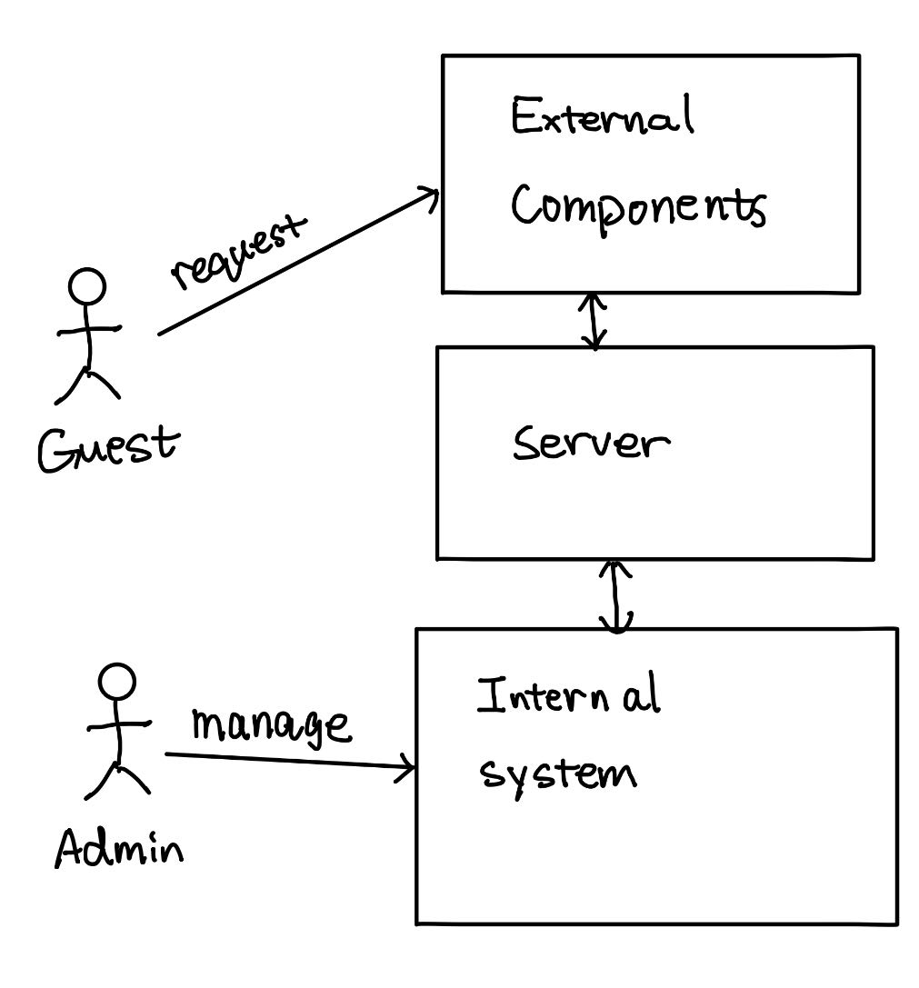
Project Overall Structure
Billing component
Guest profile component
Notification component
Reservation component
Various of Features
Inventory component
Scheduling component
Task queue component
Employee component
Feedback component
Notes:
Automata

Slide 20
Scope of Initial Release
Basic Guest Profile Management:
Create and manage simple guest profiles, including essential information such as name, contact details, and reservation history. This foundational feature supports basic personalization of service and enables the initial collection and analysis of guest data for insights.
Simplified Reservation System:
Empower hotel staff to manually add, view, and modify reservations. This streamlined system will efficiently track room availability, facilitating straightforward management of bookings without the need for complex algorithms or integration with online booking platforms.
Basic Billing Component:
Automate the generation of straightforward invoices for guests, detailing charges for their stay and any additional services selected (e.g., room rate, breakfast). This module allows for manual entry of services and payments, streamlining the billing process.
Enhanced Room Services Management:
This feature extends beyond basic room inventories to include room status tracking (clean, occupied, needs maintenance) and service requests. It enables real-time updates and communication between housekeeping, maintenance, and front desk staff to ensure rooms are prepared to guest specifications, improving operational efficiency and guest satisfaction.
Staff Management System:
Introduce a centralized platform for managing staff schedules, tasks, and communications. This system will support assignment of duties based on real-time needs and availability, track completion of tasks, and facilitate direct communication among team members. By optimizing staff allocation and enhancing coordination, this system aims to improve overall operational efficiency and responsiveness to guest needs.

Slide 21
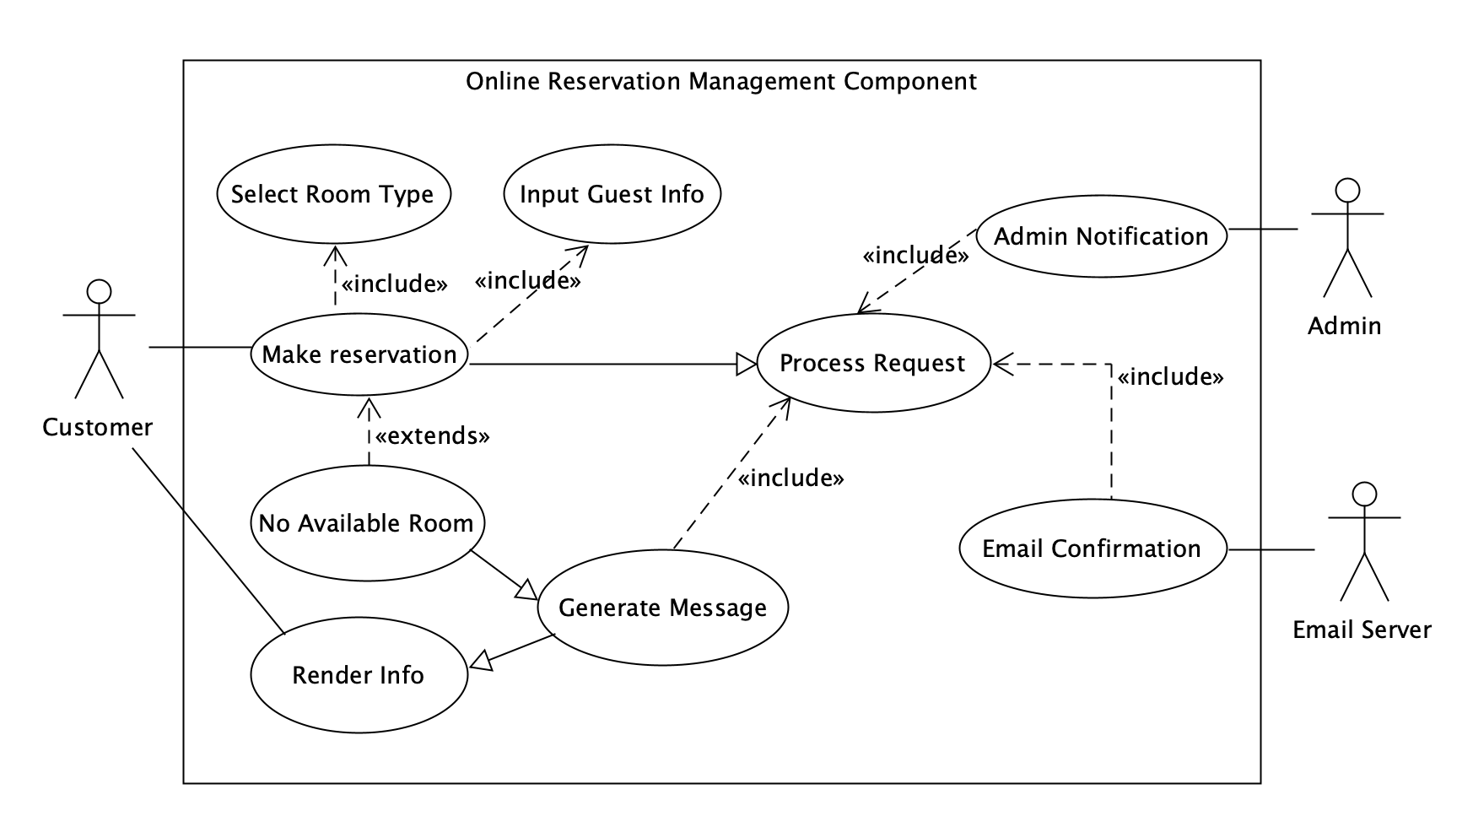
Use Case Diagram for Room Reservation
Notes:
Chun yang

Slide 22
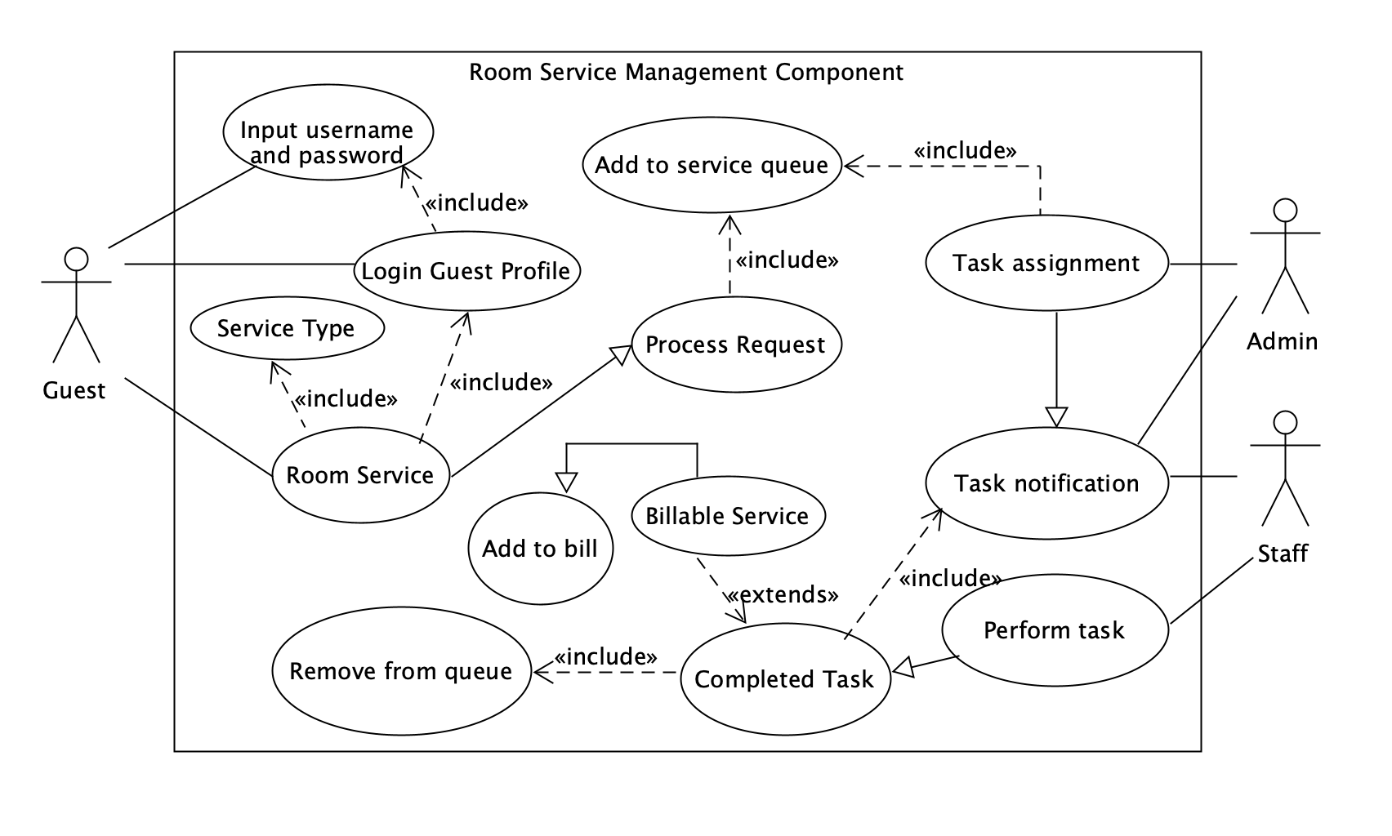
Use Case Diagram for Room Service
Notes:
Chun yang

Slide 23
Activity Diagram for Room Service
Notes:
Allen

Slide 24
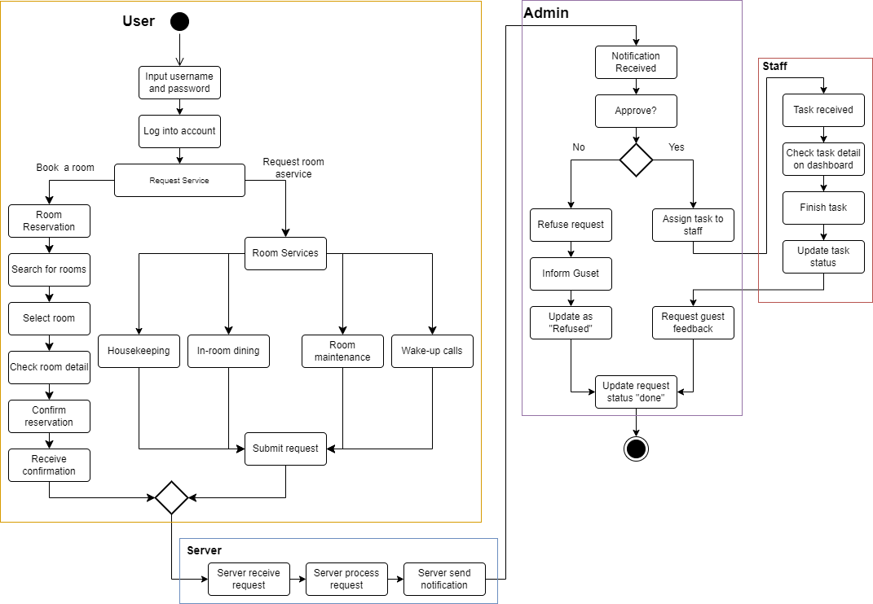
Notes:
Allen

